Slide 1







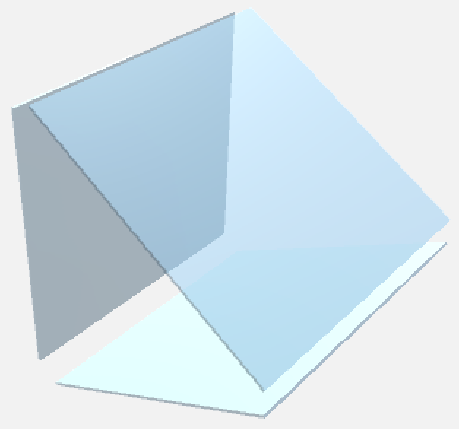
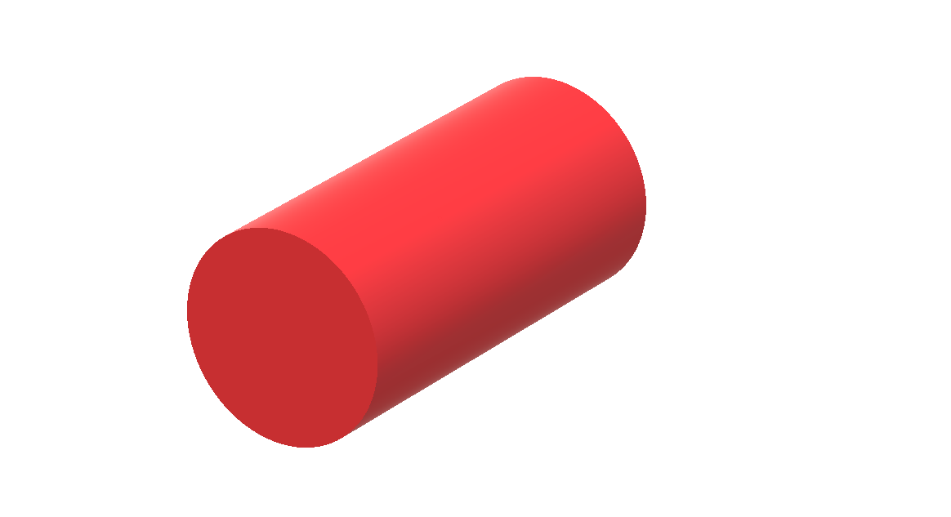
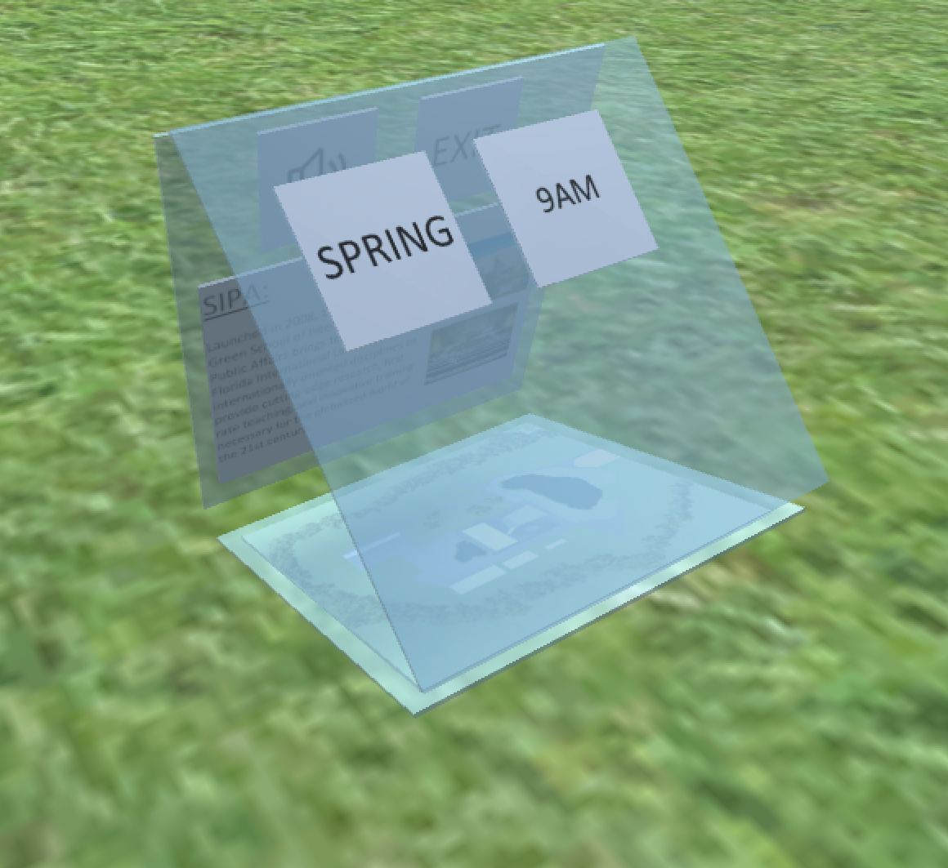
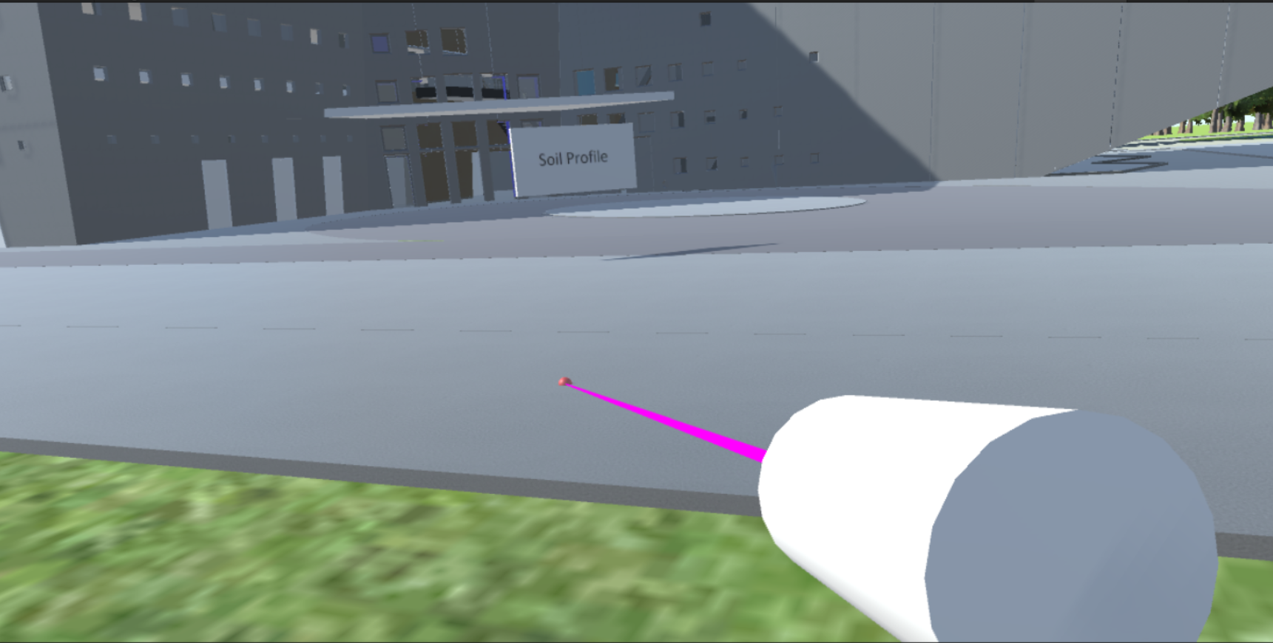
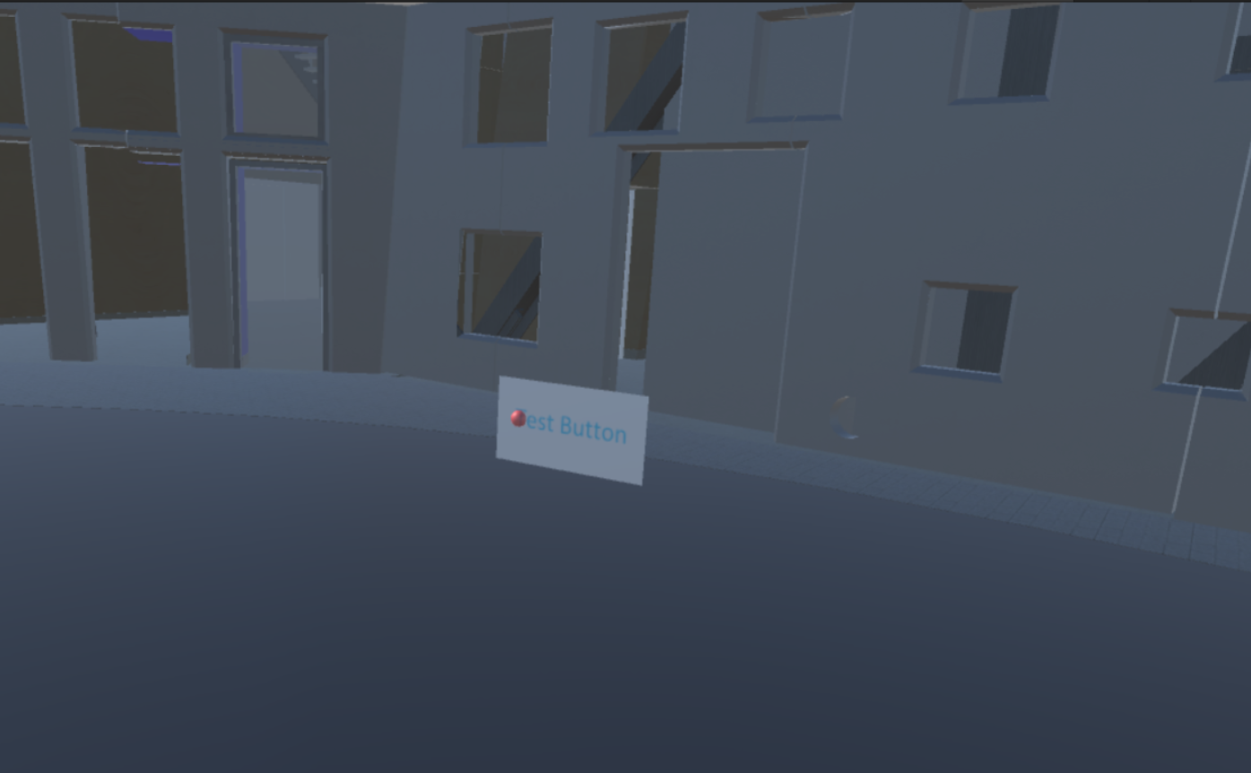
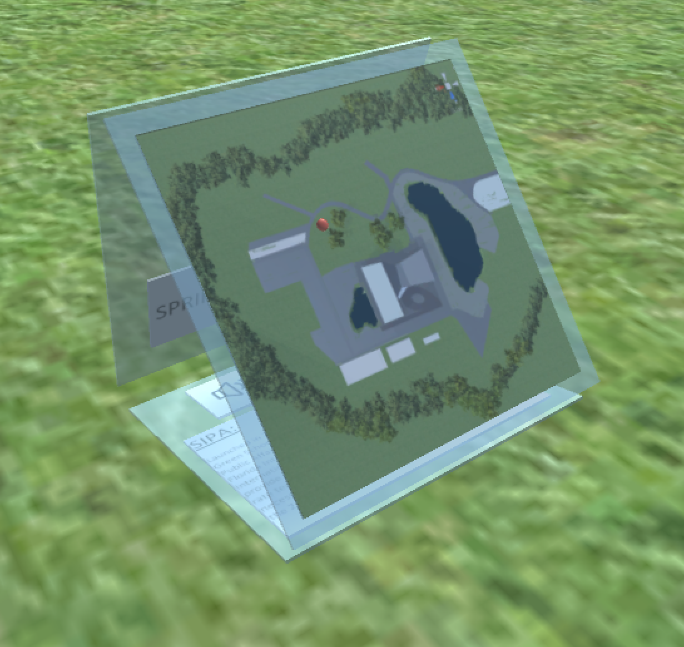
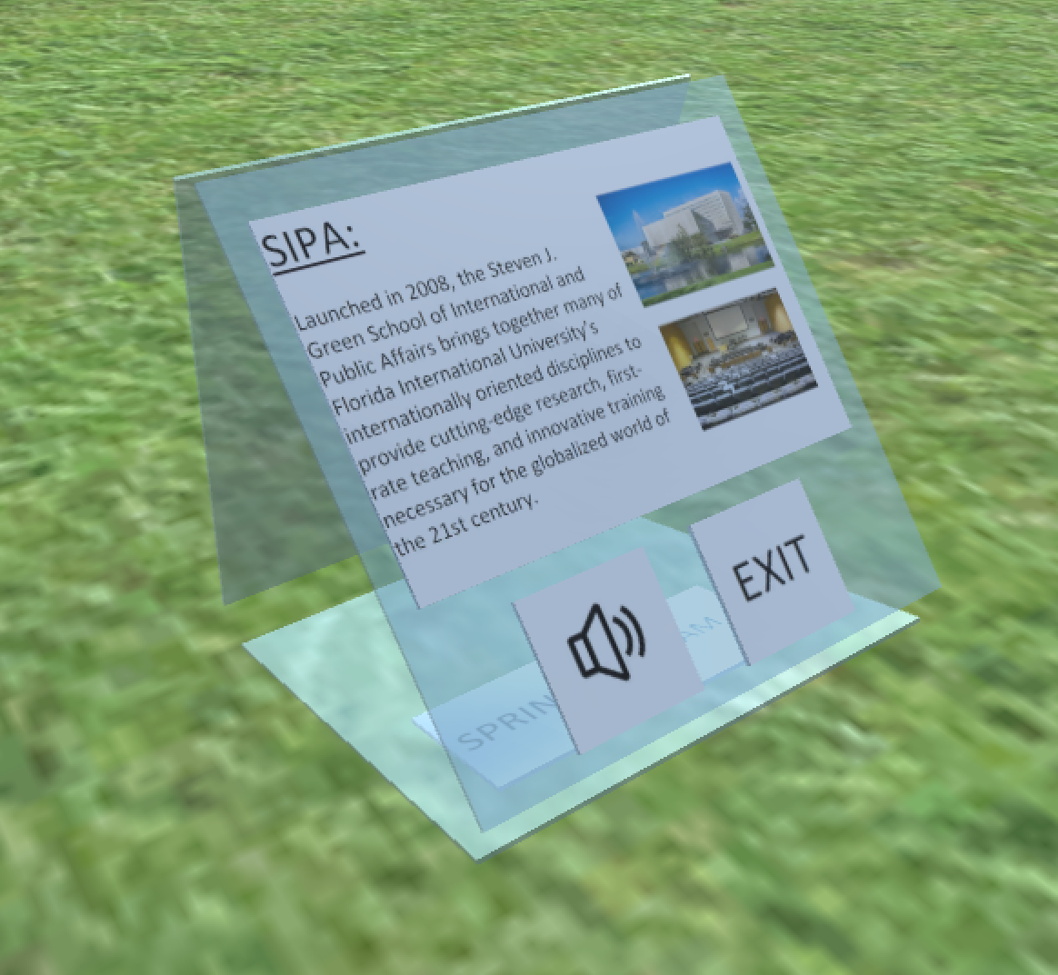
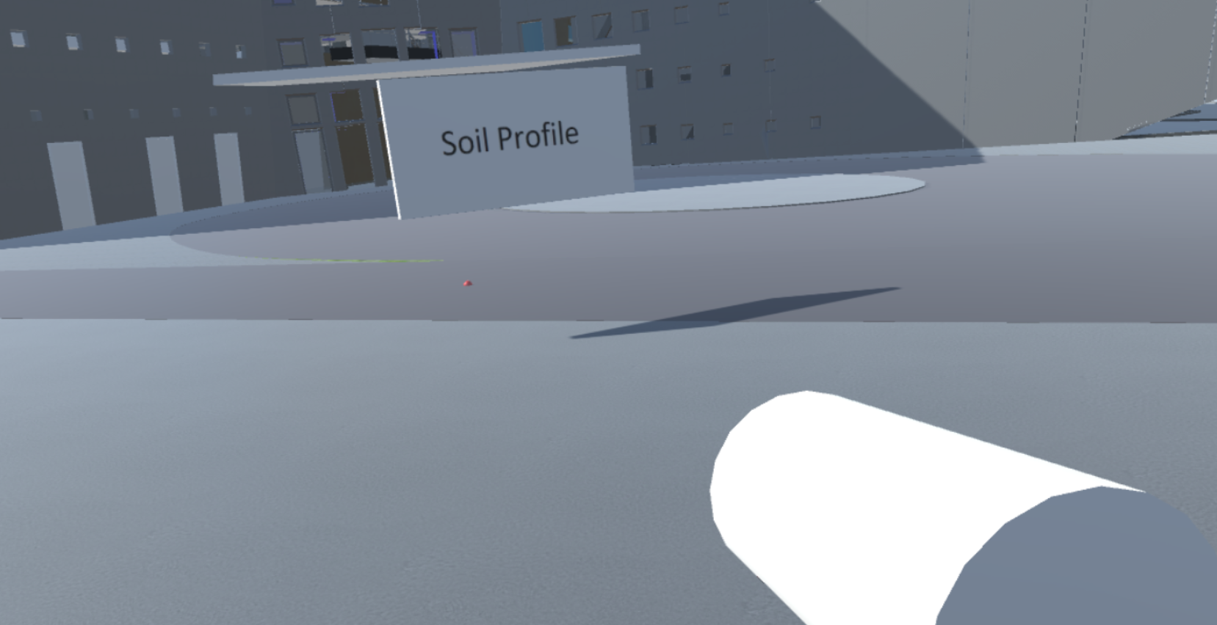
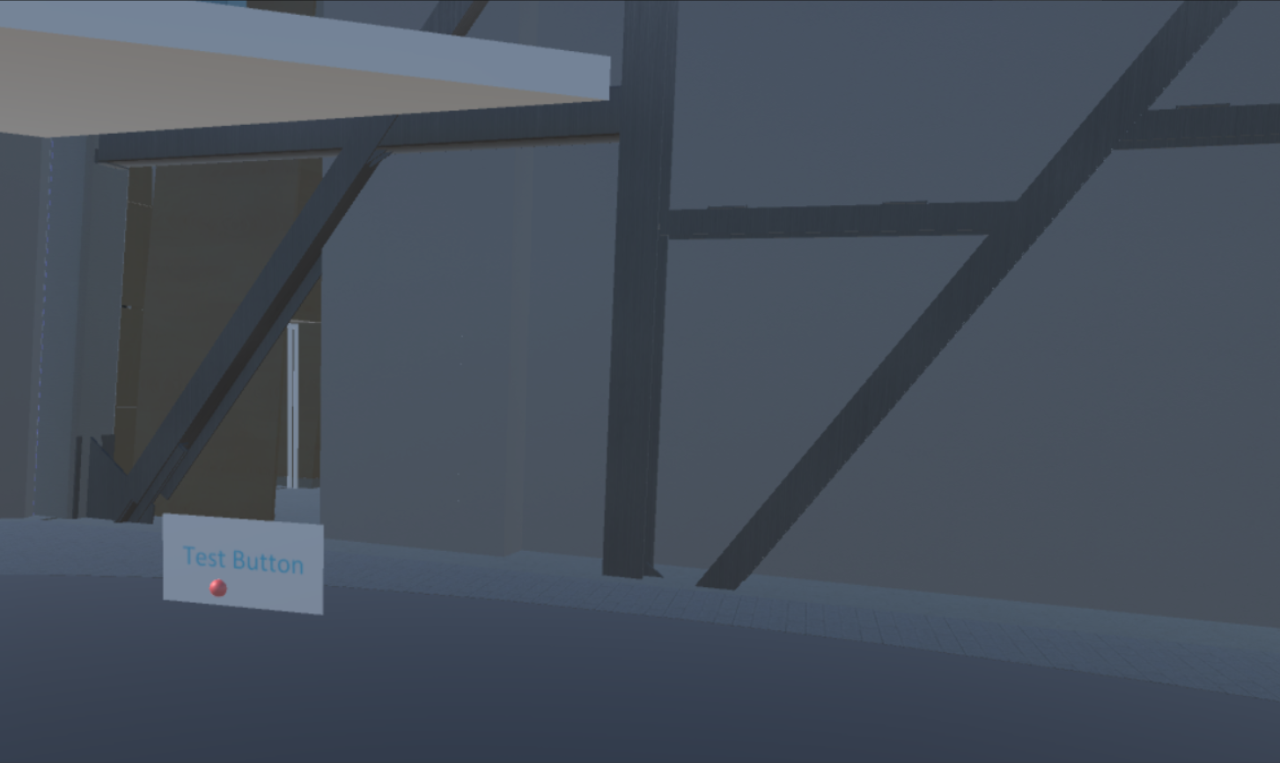
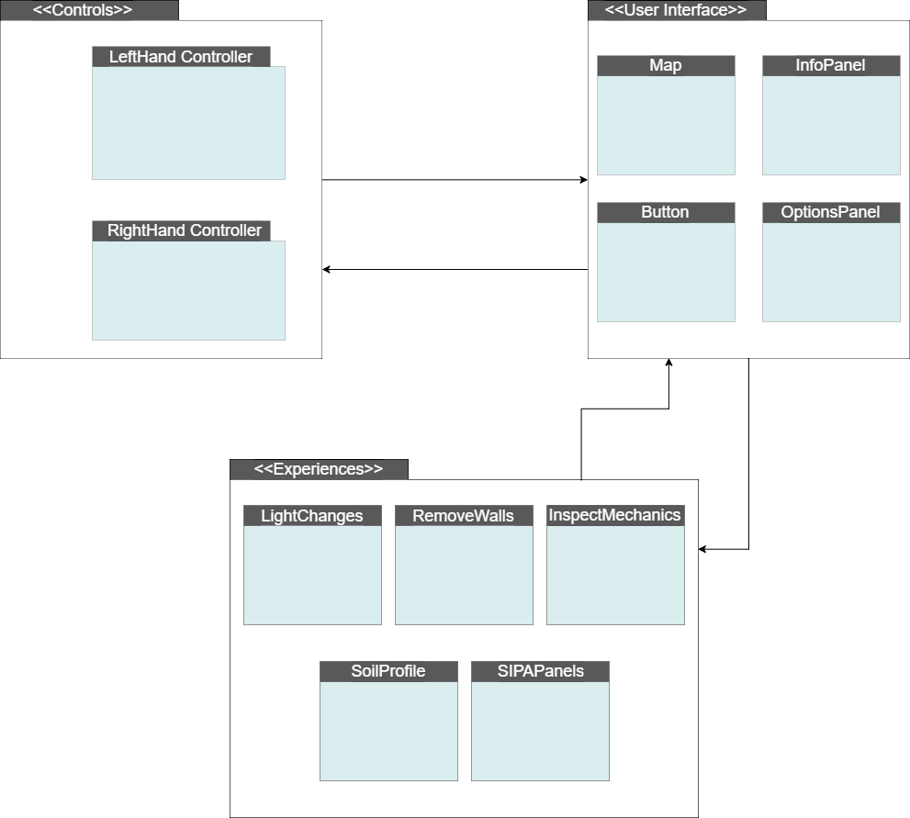
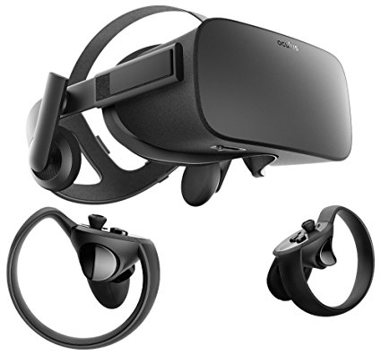


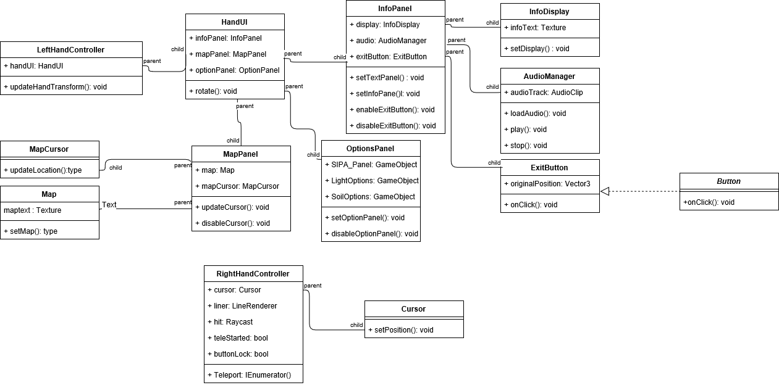
School of Computing & Information Sciences
VIP - 2017, Fall
SKOPE VR 1.0
Student: Jose Maldonado - Florida International University
Mentor: Albert Elias, Shahin Vassigh - Florida International University
Professor: Masoud Sadjadi, Francisco Ortega - Florida International University
Problem
Research shows that Virtual Reality (VR) mediated learning can improve the learning experience for students, however current VR system design approaches are unintuitive for students. Furthermore, the current systems don’t facilitate the addition of new experiences.
Solution
We present an intuitive VR design approach geared towards immersed learning. Our primary focus lies on User Interface, Open World Design and Experiences. We also placed emphasis in implementing the ability to add experiences to the system at ease.
Current System
SKOPE VR utilizes Oculus Rift VR Hardware/SDK and Unity 3D to immerse students on a full scale virtual SIPA environment. Through the open world, student will get to examine different part of SIPA both architecturally and functionally.
The Hub’s purpose is to be the Central Information and Decision Hub for the Player.
Hub
Pointer
The Pointer’s purpose is to facilitate
Movement and Interactions for the player
The Map Panel displays the player's location in the open world space. It also displays the location of different experiences scattered around the map for the player to explore.
Options
The Info Panel displays relevant information based on the players current experience in the world map. This example shows the default Info display for SIPA world space.
Movement
Interactions
The Options Panel displays relevant options a player can take for a given experience in the open world map. This example shows options for the SIPA sunlight experience
IEnumerator Teleport()
void onClick()
Map
Info
Requirements & Verification
SKOPE VR Requirements:
Accurate and Comfortable player movement around the world space.
Centralized Information Hub for Player querying and decision making based on world space location and chosen experience.
Intuitive UI interaction that reflect in connecting experiences and relevant options.
Sample Test Case
Implementation
Our system was implemented using Unity 3D, Oculus SDK and Visual Studio 2017 running on Windows 10.
System Design
VR
SDK
Test Case ID : | SKOPE_Map_UpdateLocation (Sunny Day)
Purpose | - Tests if the location of the map cursor is updated every time the player changes location.
Pre-Conditions | - Location selected is 15 meters away - Surface is Walkable - Location is within Map range
Input | - Player performs movement.
Expected Output | - Map location correctly updates it location based on player motion taken.
Object Design
Passed
Acknowledgement
The material presented in this poster is based upon the work done by Albert Elias and Prof.Shahin Vassigh in the SKOPE Project. I am thankful to the help that I received from my group members in adding experiences and brainstorming new and innovative ways to tackle UI in Virtual Reality.
Notes:
1

